Slide 1
Microcontroller, Computer Peripherals and Interfacing
Dr. Md. Johirul Islam Associate Professor Department of Physics Rajshahi University of Engineering and technology johirulap@gmail.com, Johirul@phy.ruet.ac.bd

Slide 2
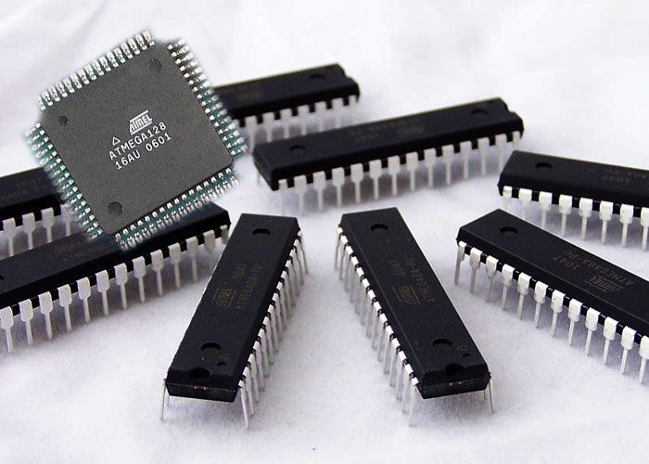
What is a microcontroller?
A microcontroller (sometimes abbreviated µC, uC or MCU) is a small computer
on a single integrated circuit
containing a processor core, memory, and programmable input/output peripherals.
It can only perform simple task.

Slide 3
Advantages of Microcontrollers
Microcontrollers act as a microcomputer without any digital parts.
As the higher integration inside microcontroller reduces cost and size of the system.
Usage of a microcontroller is simple, easy to troubleshoot and system maintaining.
Most of the pins are programmable by the user for performing different functions.
Easily interface additional RAM, ROM,I/O ports.
Low time required for performing operations.

Slide 4
Disadvantages of Microcontrollers
Microcontrollers have got more complex architecture than that of microprocessors.
Only perform a limited number of executions simultaneously.
Mostly used in micro-equipments.
Cannot interface high power devices directly.

Slide 5

Applications of microcontroller

Slide 6
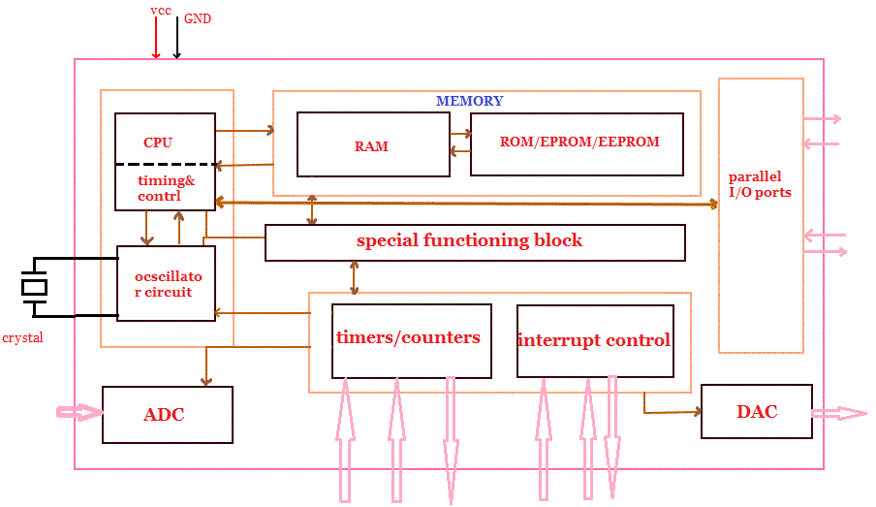
Microcontroller Structure

Slide 7
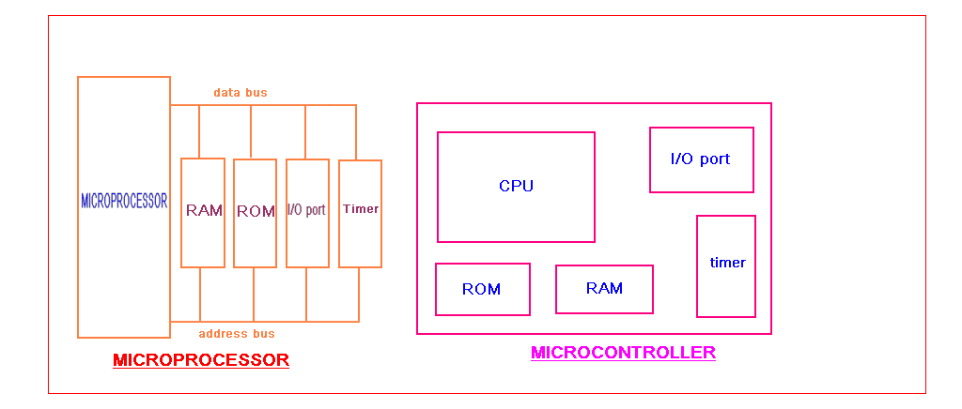
Microcontroller Vs Microprocessor

Slide 8
Microcontroller Vs Microprocessor
Microprocessors Microcontrollers
 | It is only a general purpose computer CPU | It is a microcomputer itself
 | Memory, I/O ports, timers, interrupts are not available inside the chip | All are integrated inside the microcontroller chip
 | This must have many additional digital components to perform its operation | Can function as a microcomputer without any additional components.
 | Systems become bulkier and expensive. | Make the system simple, economic and compact
 | Higher accessing time required | Low accessing time
 | Very few pins are programmable | Most of the pins are programmable
 | Very few number of bit handling instructions | Many bit handling instructions
 | Widely Used in modern PC and laptops | widely in small control systems
 | INTEL 8086,INTEL Pentium series | INTEL8051,89960,PIC16F877

Slide 9
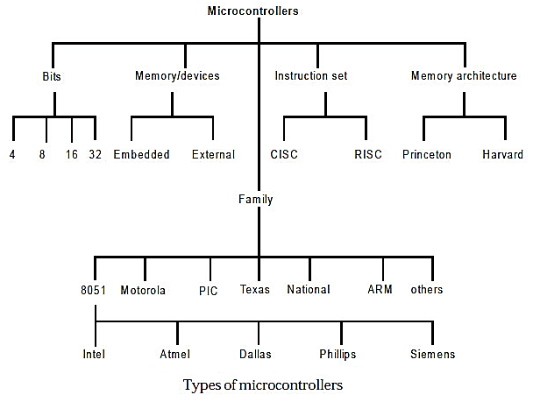
Types of Microcontroller

Slide 10
Bits
It indicates the number of bit it can process at a time.
4-bit microcontroller: Atmel MARC4, Toshiba T3400
8-bit microcontroller: Intel 8031/8051, PIC1x and Motorola MC68HC11 families.
16-bit microcontroller: 8051XA, PIC2x, Intel 8096 and Motorola MC68HC12 families.
32-bit microcontroller: Intel/Atmel 251 family, PIC3x.

Slide 11
Memory/Devices
Embedded microcontroller: When an embedded system has an MCU that has all the hardware and software units in a single unit, the MCU is called embedded microcontroller. Very few or no other external unit or system is present for processing during the control or use of the external devices. For example, a telephone handset circuit uses an embedded microcontroller.
External memory microcontroller: When an embedded system has an MCU that has all the hardware and software units present not as a single unit and has all or part of the memory unit externally interfaced using an interfacing circuit which is called the glue circuit, the MCU is called an external memory microcontroller. For example, 8031 has the program memory which is interfaced externally to it. The 8051 has both internal as well as external program memory.

Slide 12
Memory Architecture
Harvard Memory Architecture Microcontroller: The point when a microcontroller unit has a dissimilar memory address space for the program and data memory, the microcontroller has Harvard memory architecture in the processor.
Princeton Memory Architecture Microcontroller: The point when a microcontroller has a common memory address for the program memory and data memory, the microcontroller has Princeton memory architecture in the processor.

Slide 13
Reduced Instruction Set Architecture (RISC)
The main idea behind this is to simplify hardware by using an instruction set composed of a few basic steps for loading, evaluating, and storing operations just like a load command will load data, a store command will store the data.
Characteristics of RISC
Simpler instruction, hence simple instruction decoding.
Instruction comes undersize of one word.
Instruction takes a single clock cycle to get executed.
More general-purpose registers.
Simple Addressing Modes.
Fewer Data types.
A pipeline can be achieved.

Slide 14
Advantages of RISC
Simpler instructions: RISC processors use a smaller set of simple instructions, which makes them easier to decode and execute quickly. This results in faster processing times.
Faster execution: Because RISC processors have a simpler instruction set, they can execute instructions faster than CISC processors.
Lower power consumption: RISC processors consume less power than CISC processors, making them ideal for portable devices.
Disadvantages of RISC
More instructions required: RISC processors require more instructions to perform complex tasks than CISC processors.
Increased memory usage: RISC processors require more memory to store the additional instructions needed to perform complex tasks.
Higher cost: Developing and manufacturing RISC processors can be more expensive than CISC processors.

Slide 15
Complex Instruction Set Architecture (CISC)
The main idea is that a single instruction will do all loading, evaluating, and storing operations just like a multiplication command will do stuff like loading data, evaluating, and storing it, hence it’s complex.
Characteristics of CISC
Complex instruction, hence complex instruction decoding.
Instructions are larger than one-word size.
Instruction may take more than a single clock cycle to get executed.
Less number of general-purpose registers as operations get performed in memory itself.
Complex Addressing Modes.
More Data types.

Slide 16
Advantages of CISC
Reduced code size: CISC processors use complex instructions that can perform multiple operations, reducing the amount of code needed to perform a task.
More memory efficient: Because CISC instructions are more complex, they require fewer instructions to perform complex tasks, which can result in more memory-efficient code.
Widely used: CISC processors have been in use for a longer time than RISC processors, so they have a larger user base and more available software.
Disadvantages of CISC
Slower execution: CISC processors take longer to execute instructions because they have more complex instructions and need more time to decode them.
More complex design: CISC processors have more complex instruction sets, which makes them more difficult to design and manufacture.
Higher power consumption: CISC processors consume more power than RISC processors because of their more complex instruction sets.

Slide 17
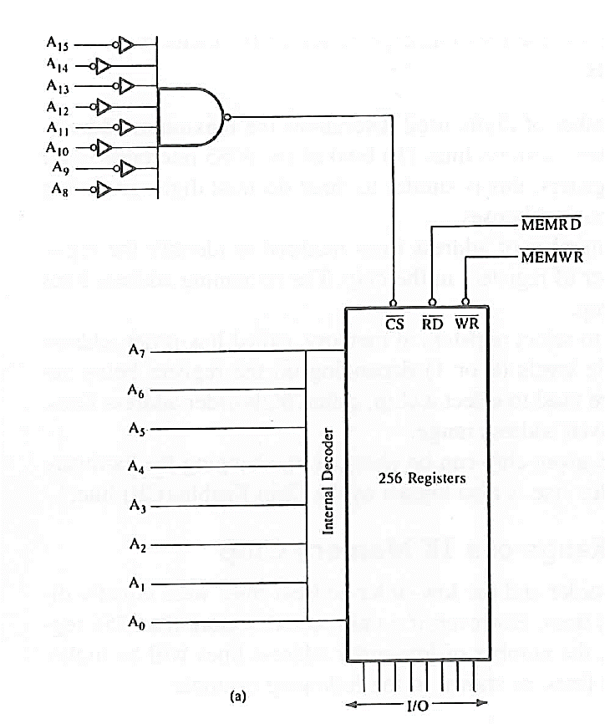
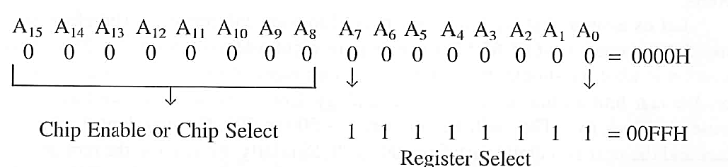
Memory Interfacing

Slide 18
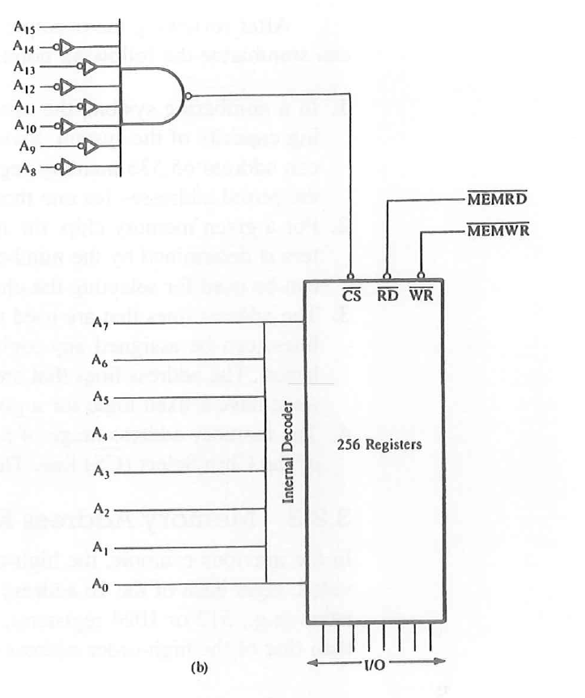
Memory Interfacing
Address ranges ?

Slide 19
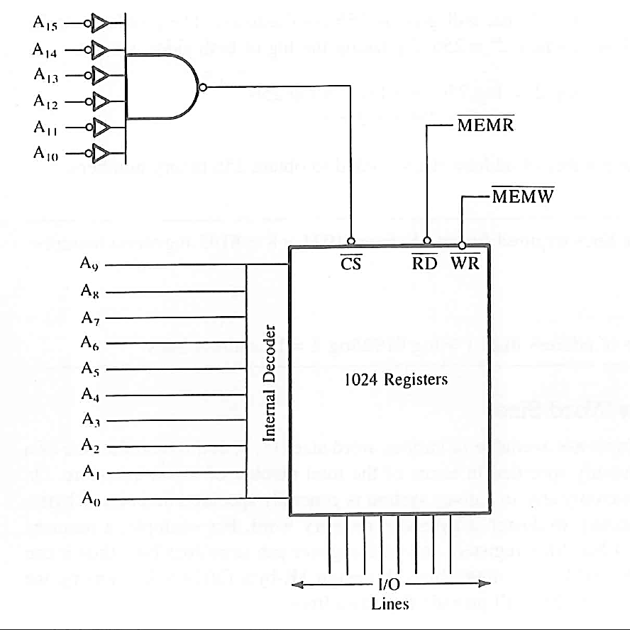
Memory Interfacing

Slide 20
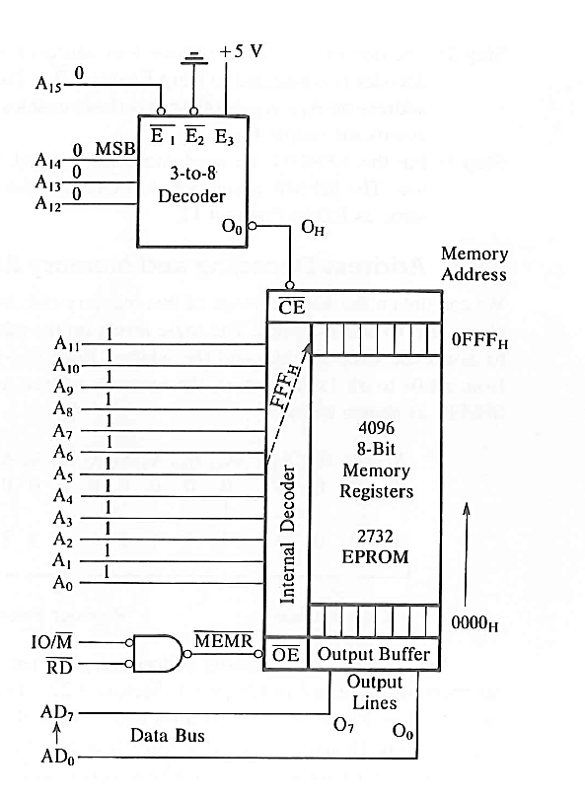
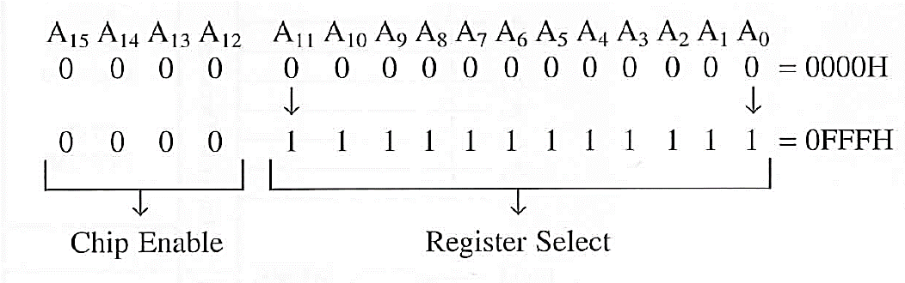
Memory Interfacing Using 3 to 8 Decoder
Memory

Slide 21
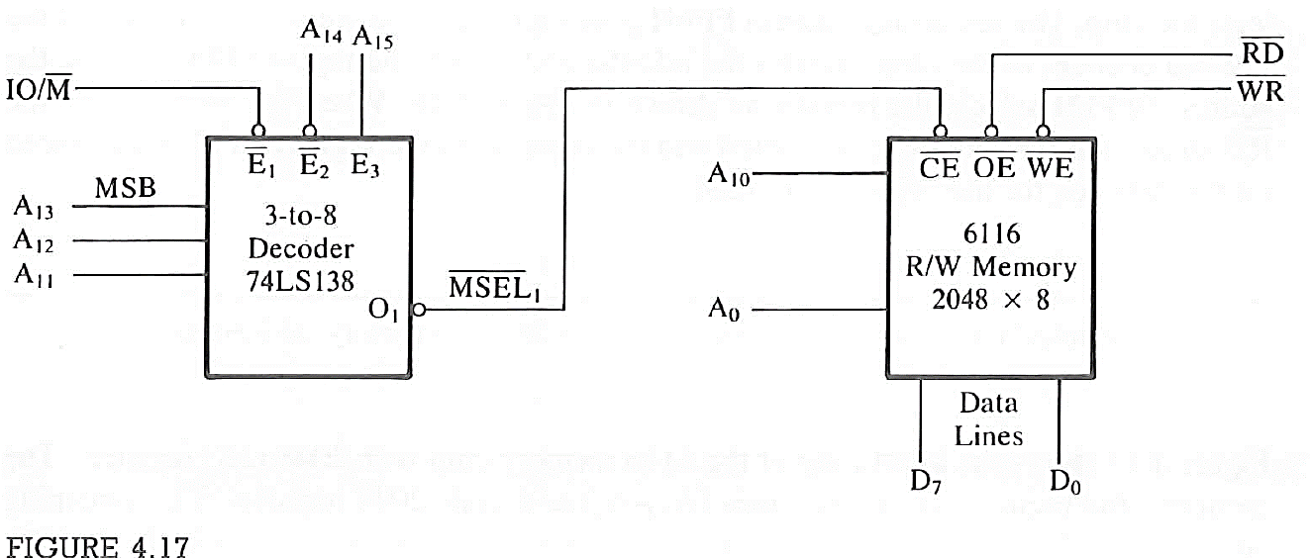
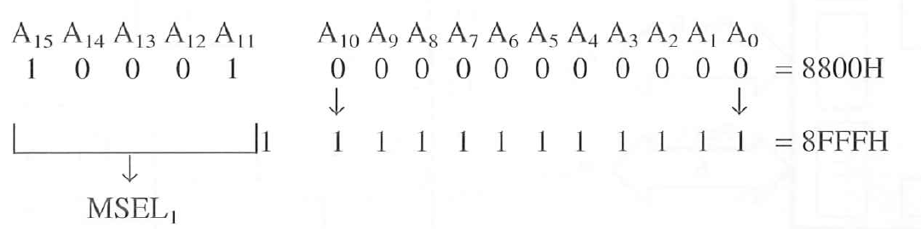
Memory Interfacing Using 3 to 8 Decoder

Slide 22
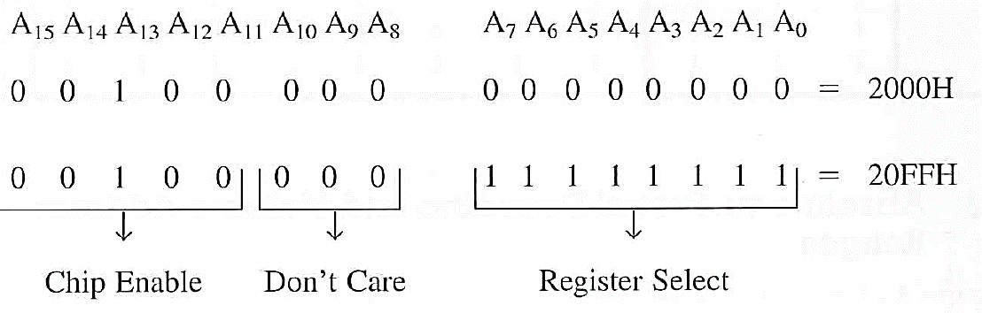
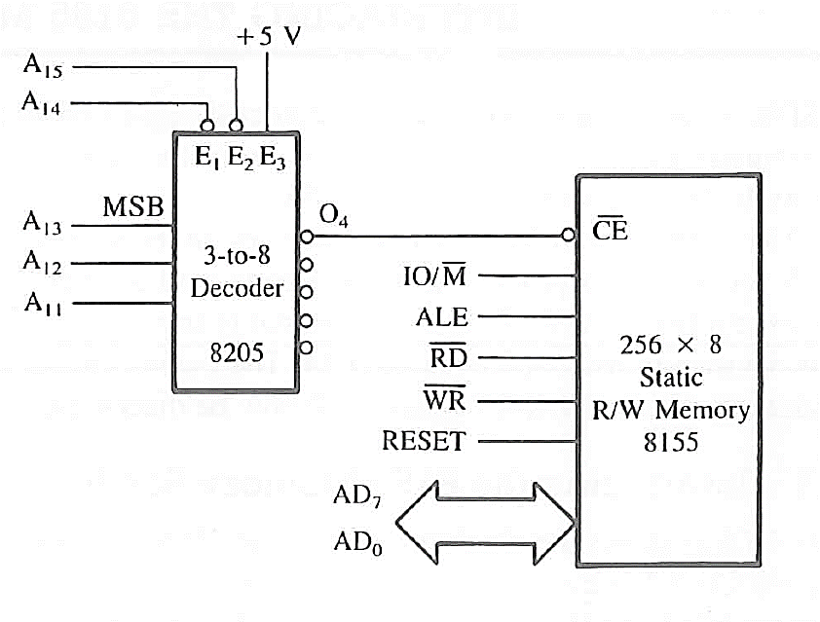
Memory Interfacing Using Partial Decoding

Slide 23
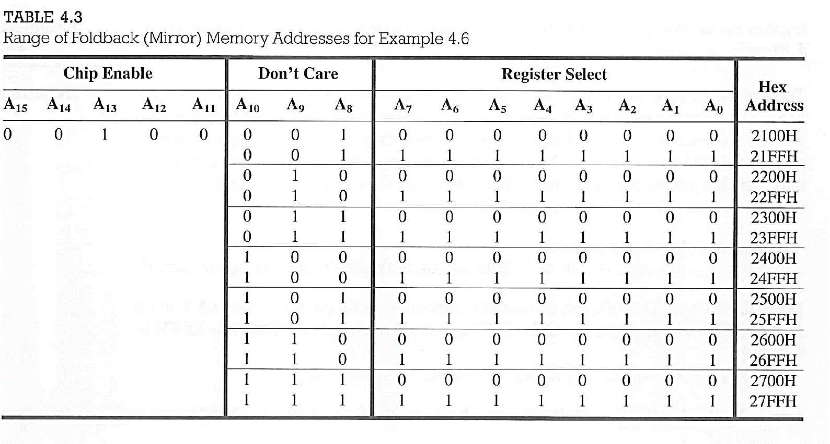
Partial Decoding of Memory and Multiple Addresses

Slide 24
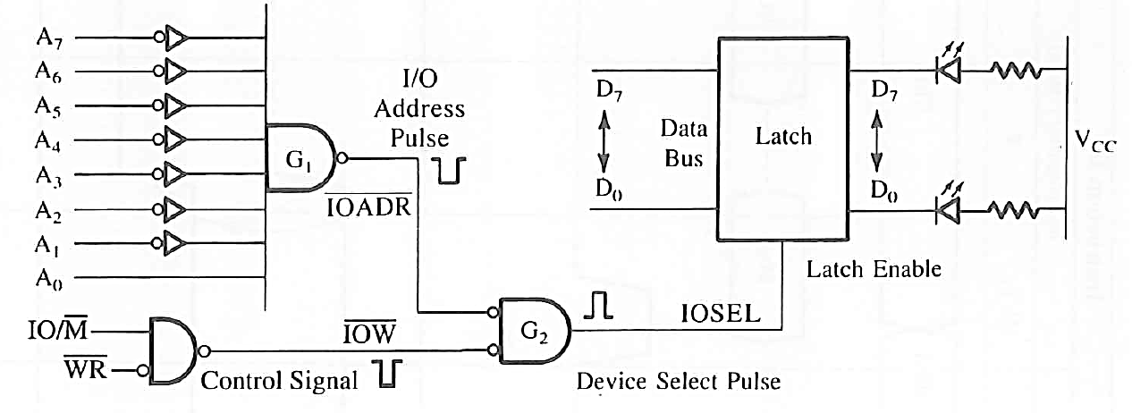
Output Interfacing using NAND Gate
Port Address 01H

Slide 25
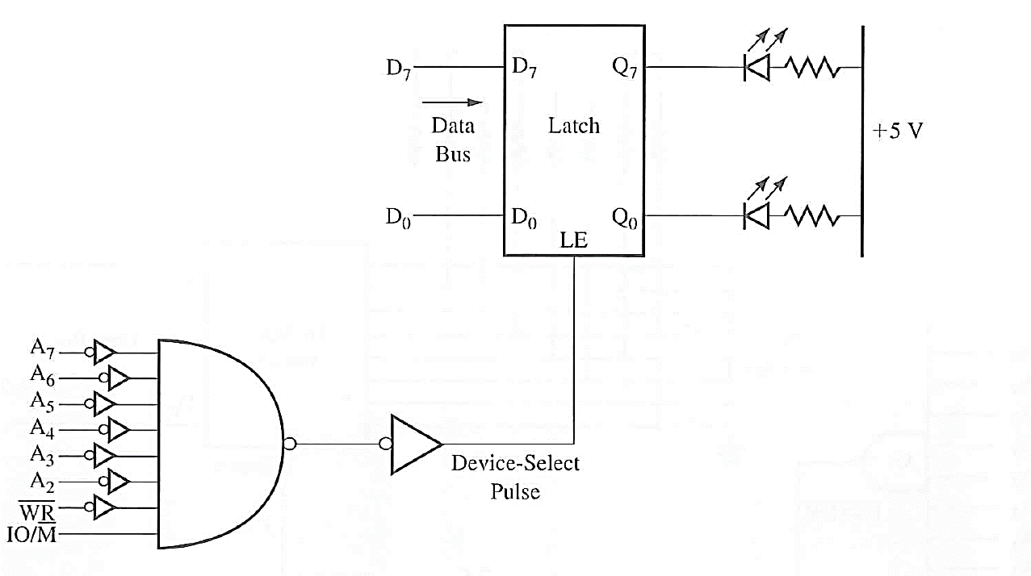

Output Interfacing using Partial Decoding

Slide 26
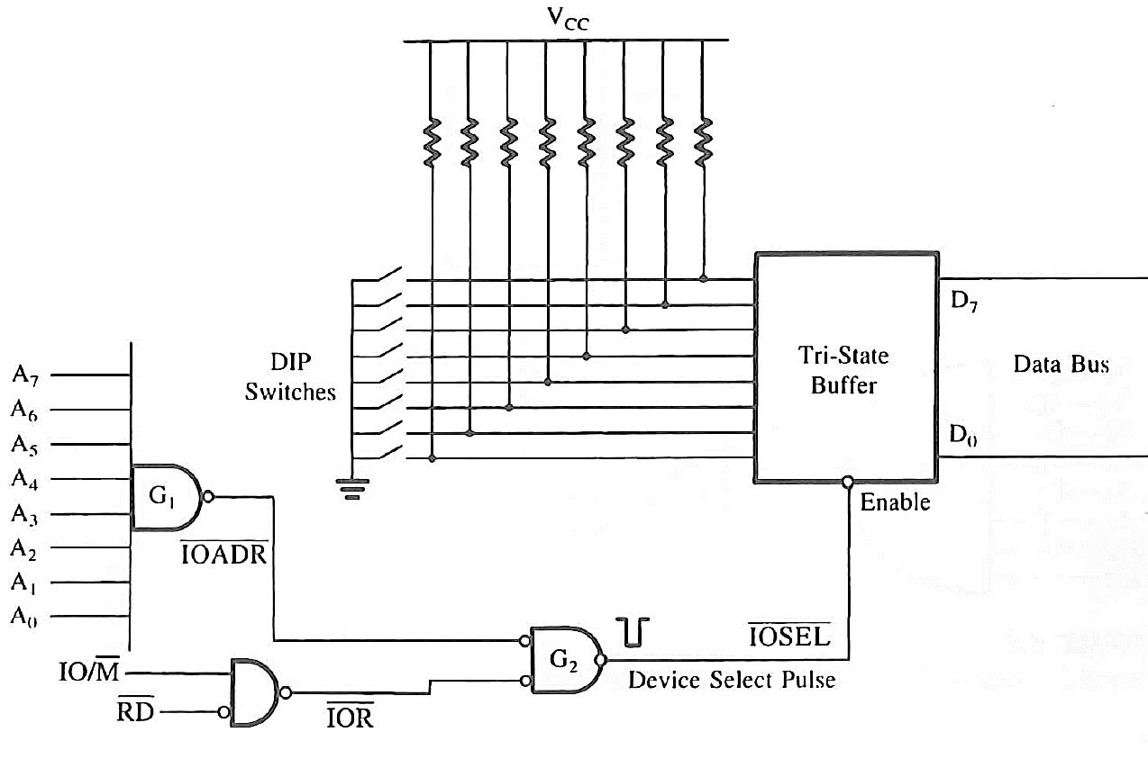
Input Interfacing using NAND Gate

Slide 27
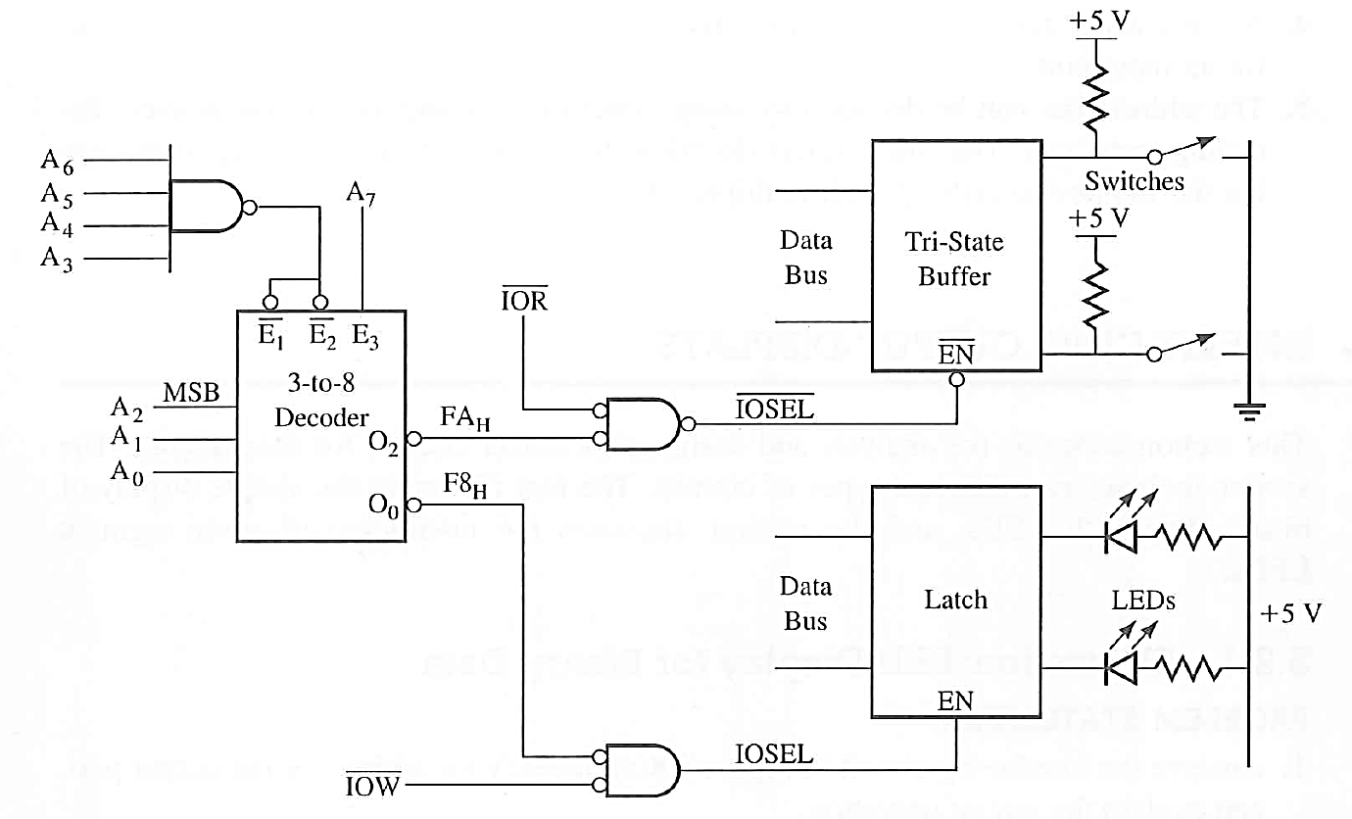
I/O Interfacing using 3 to 8 Decoder

Slide 28
Memory Mapped I/O ??????? (Modify it)

